Slide 1
DASH BOARD ON NETFLIX DATASET
BY PRAJWALA

Slide 2
Explanation of Netflix Dataset on Netflix Dataset
Description
show id, Type Type, Title, director, Cast, Cast, Country, Date added, Release year, Raring , Duration, listed in
Analysis
Total no rows=8808
Total no of columns=12
Total no of movies=6131
Total no of tv shows=2676

Slide 3
Objctives
Analyse the movies and tv shows present on Netflix using excel tools.
To find information about particular show id.
• percentage Type
• Total count of release
• Count of rating
• Cast of movies and tv shows
• Count of Director of Top 10 Countries
• count duration of movies and tv shows
• Count of top 10 listed in

Slide 4
 | In pie chart
 | We can see percentage of type
 | we see here
 | movies=69.62%
 | Tv shows=30.38%
 | In clustered column chart
 | We can see count of release date from 1995 to 2021
 | here we can see
 | most of the movies and shows released in the year |  |  |  |  | 2018 that is count of 1187
 | we can see the count of release is decresing after 2018

Slide 5
 | In clustered column chart
 | Count of rating is high |  | h for Tv Ma with | a with 3207
 | Tv 14 is with 2160
 | again we canc see the dcrease of rating after Tv ma
 | In bar chart
 | Count of cast is more in movies compare to Tv shows
 | moives=5656.00
 | Tv shows=2326.00 | 2326.00.

Slide 6
 | In clustered column chart
 | here count of directors of top 10 countries
 | we can see top 1st place in united states with count of directors are 2048 |  |  |  |  |  |  | .
 | second place is India and last place in top 10 list is France with 81.
In clustered column chat
Movies = | 6128 on time base
Tv shows are 2676 sesons.

Slide 7
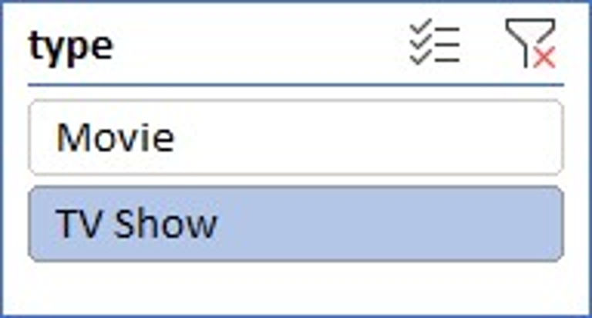

Slide 8
 | Insights
 | slicer:
 | type
 | Percentage of type:
 | Tv shows:30.38% Movies : 69.62%
 | Release per year:
 | in 2018 --1187 and decresing after 2018
 | Ratings:
 | the majority of the content is for Tv Ma ,most are intendedto viewing
 | by mature and adult audiences.
 | Cast:
 | cast in movies are 5656
 | cast in tv shows 2636

Slide 9
THANK YOU

